Slide 1
CSS Colors and Accessibility
BY Giovanni g.a
CLASS OF 2027

Slide 2
What is CSS Colors & Accessibility?

Slide 3
What is CSS Colors & Accessibility?
🎨
For CSS colors and accessibility, it's crucial to ensure sufficient color contrast between text and background elements, as low contrast makes content unreadable for users with visual impairments or those in bright environments.
Achieving a minimum contrast ratio (often 4.5:1 for normal text) is essential for meeting WCAG (Web Content Accessibility Guidelines) standards.

Slide 4
Key Term & Elements

Slide 5
Key Term & Elements
🔑
Color Contrast Ratio The numerical difference in luminosity (brightness) between the text (foreground) and background. A higher ratio means better readability.
1

Slide 6
Key Term & Elements
🔑
WCAG (Web Content Accessibility Guidelines): The international standards that define required minimum contrast ratios (e.g., 4.5:1 for normal text) to ensure content is accessible.
2

Slide 7
Key Term & Elements
🔑
Color Blindness (CVD): A reduced ability to distinguish colors. Designers should avoid relying on color alone to convey information, as low contrast makes content inaccessible for users with CVD.
3

Slide 8
Visual Example / Code Snippet

Slide 9
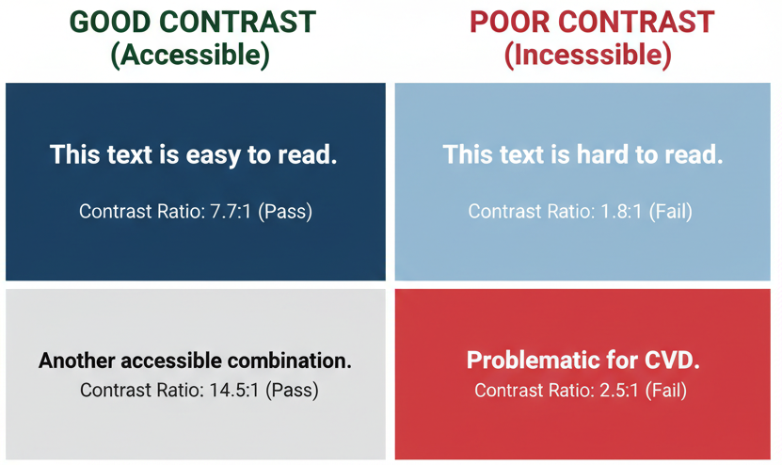
Visual Example / Code Snippet
👁️

Slide 10
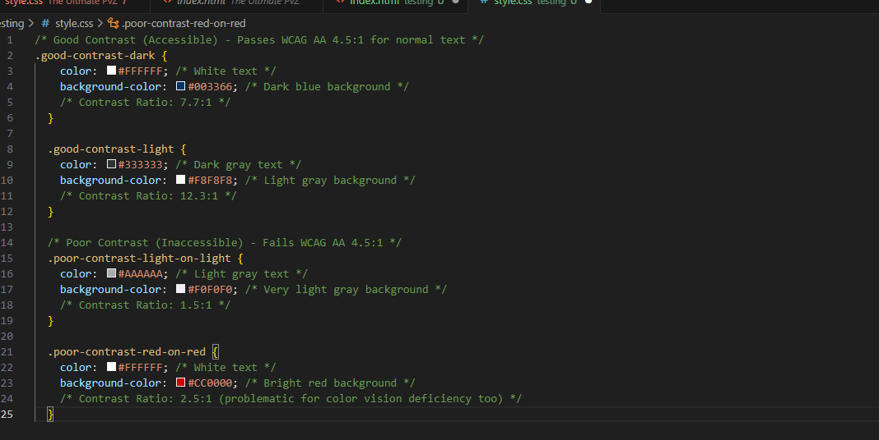
Visual Example / Code Snippet
👁️

Slide 11
Common Mistakes / Tips

Slide 12
Common Mistakes / Tips
🛑
Low Color Contrast
This is the failure to ensure enough difference in lightness between text (foreground) and its background.
The Mistake: Using colors that are too similar, such as light grey text on a white background, making the content unreadable for users with low vision.
How to Avoid: Always check the contrast ratio. Use a tool to confirm your color pairs meet the WCAG AA standard of at least 4.5:1 for normal text.+

Slide 13
Common Mistakes / Tips
🛑
Relying on Color Only
This mistake involves using color as the sole way to convey crucial information or meaning.
The Mistake: Indicating a required form field with only a red border or marking a link by only changing its color, which makes the information inaccessible to users with color blindness.
How to Avoid: Use a second visual cue. For errors, use text labels (e.g., "Error"), icons, or bolding. For links, ensure they are underlined or have another non-color style change.

Slide 14
Common Mistakes / Tips
🛑
Ignoring Non-Text & Focus Contrast
This is when interactive element contrast (like input borders and icons) and the focus indicator aren't visible enough.
The Mistake: Using low-contrast borders on input fields or an outline that is too faint when a user tabs to a button, which hinders keyboard navigation.
How to Avoid: Ensure all UI components and their :focus states meet a 3:1 contrast ratio against the background so users can clearly see what element they are interacting with.

Slide 15
Key Takeaway

Slide 16
Web content accessibility guidelines
Key Takeaway
🚀
This topic is crucial because it ensures readability and usability for all users, fulfilling legal and ethical accessibility standards (WCAG).

Slide 17
Key Takeaway
🚀
This is a foundational skill that impacts:
Design Systems: Essential for defining accessible, high-contrast color palettes used in component libraries.
UI/UX Design: Core to designing effective interfaces where color is used correctly for status and interaction (e.g., links, errors) without relying on it solely.
Advanced CSS: Necessary when implementing features like dark mode, which requires managing multiple, accessible color themes, often with CSS variables.

Slide 18
THE END

Slide 19

THE END

